Slide 1





</> DEVELOPMENT
PRESENTED BY
Open Source
Rahul (962222201045)
Abinesh (962222201001)
Fredrick Roger (962222201028)
Santhosh Sharuk (962222201052)
GUIDE
Mrs.A.Jenisha, Assistant Professor

Slide 2


VOXCMD

Slide 3
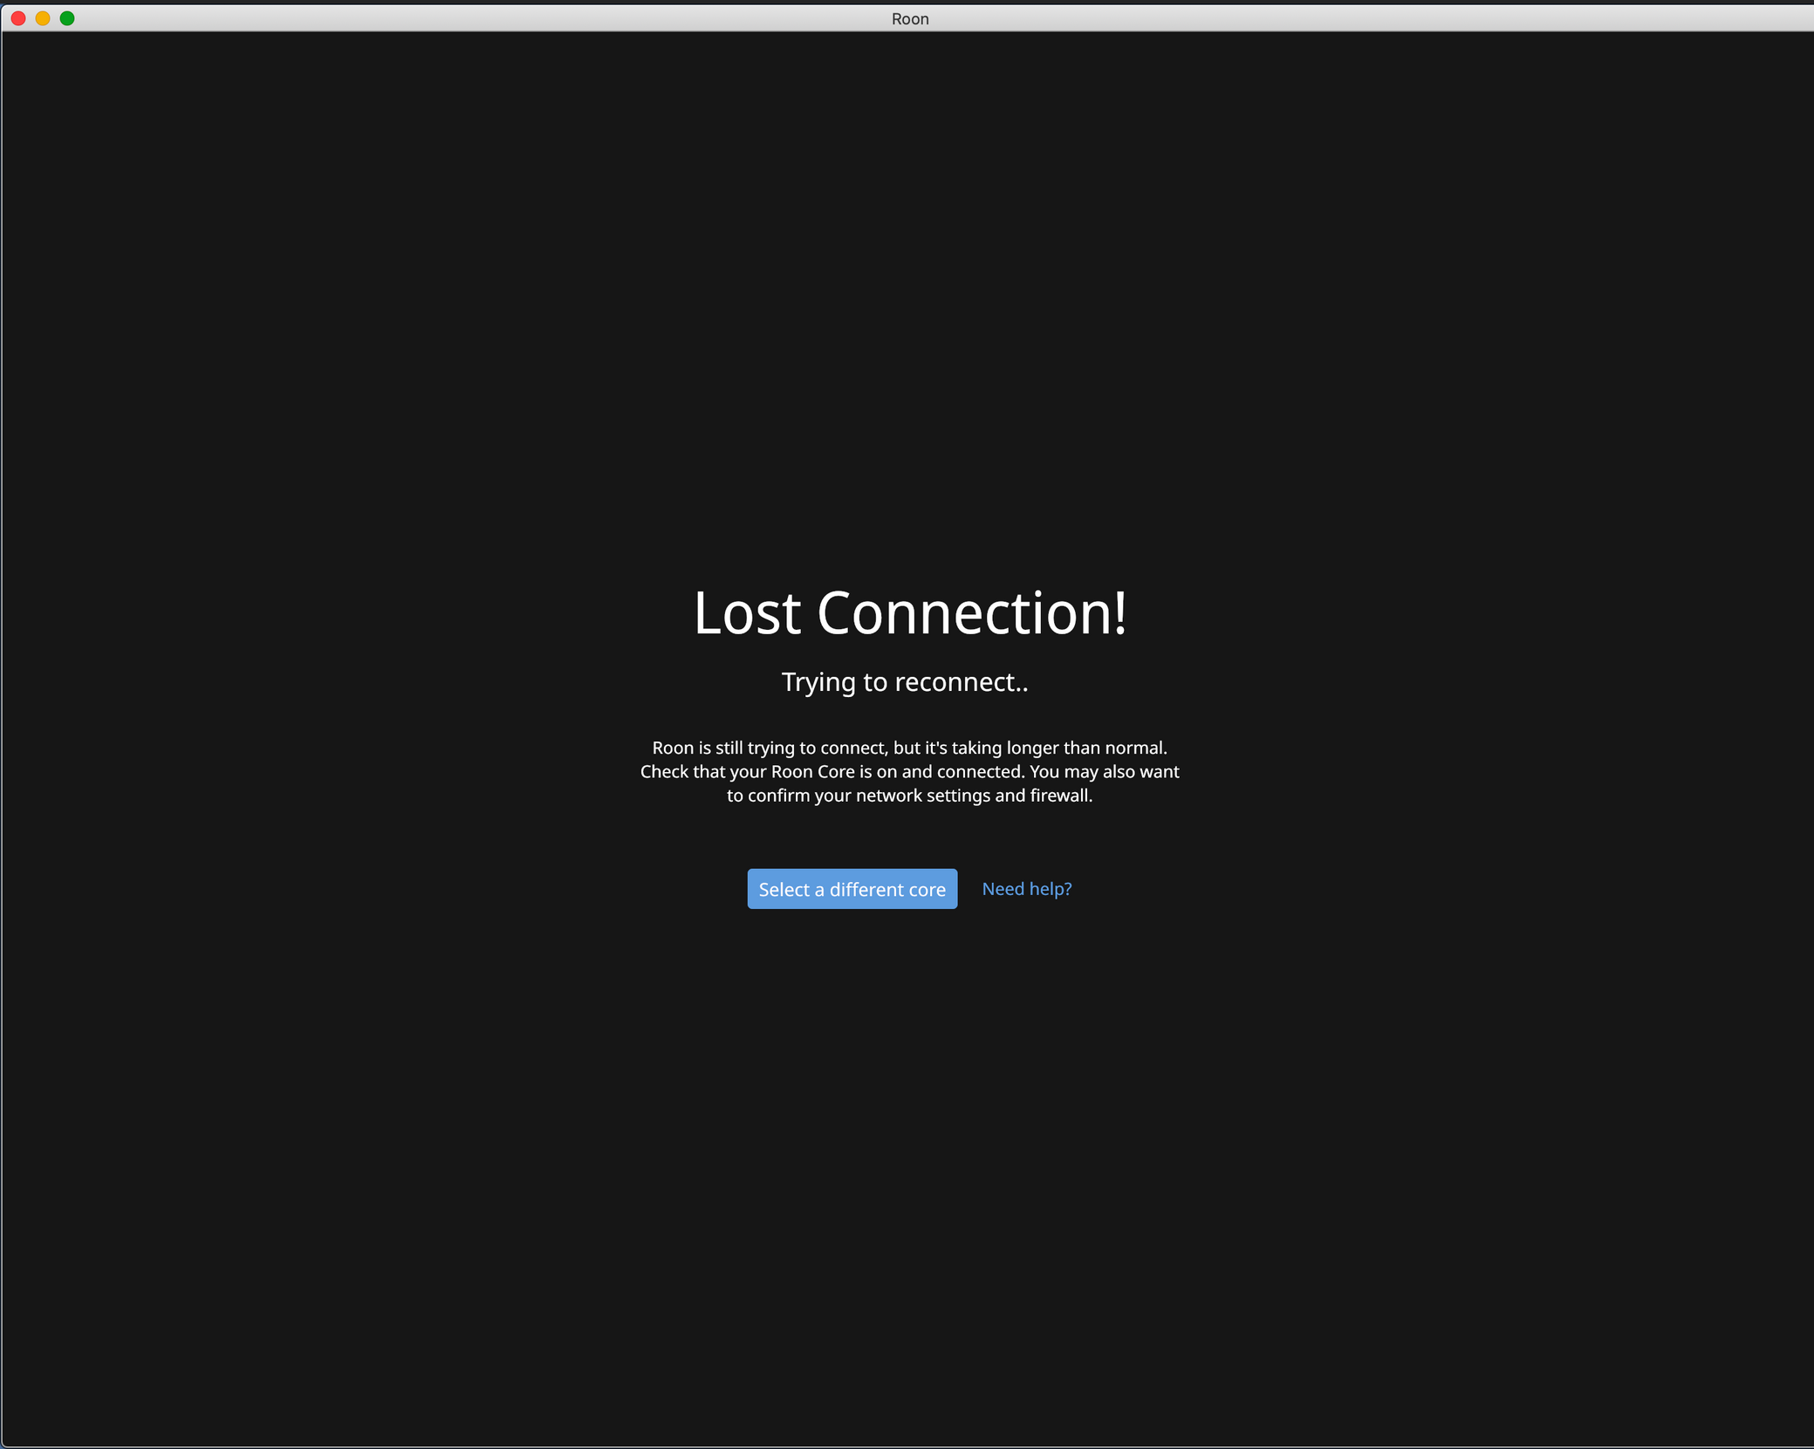
VOXCMD

Slide 4
ABSTACT
SECURE OFFLINE AI
VoxCMD operates completely offline, ensuring data privacy and security without compromising functionality.
MULTI-AGENT AUTOMATION
Provides specialized agents for productivity, coding, and system control to streamline workflows.
PRIVACY & OPEN SOURCE
Guarantees zero cloud dependency, complete user privacy, and transparent open-source architecture.

Slide 5
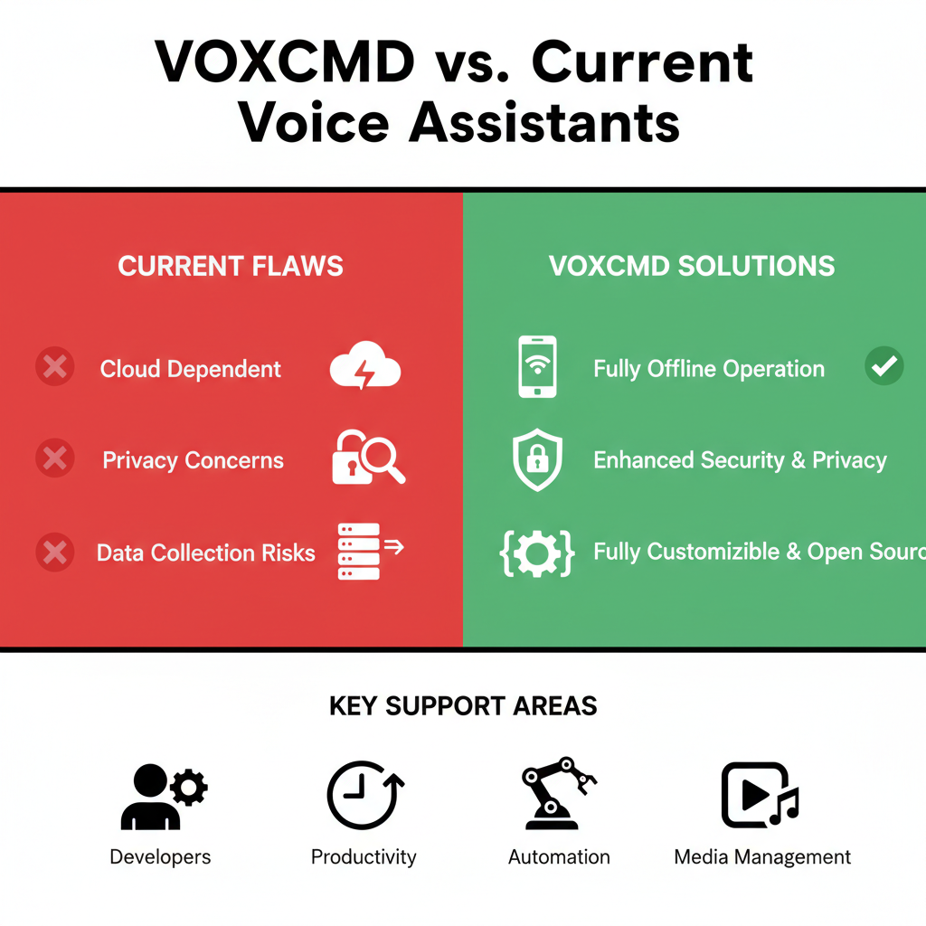
INTRODUCTION TO VOXCMD

Slide 6
PROBLEM STATEMENT
The Core Conflict
Current voice systems force users to sacrifice privacy for functionality.
Core Issues with Existing Systems
Privacy Compromised: They are entirely cloud-dependent, meaning your voice data is constantly sent, collected, and stored by vendors, creating a massive privacy risk.
Workflow Inefficient: Developers must switch between many separate, fragmented tools for coding, system control, and content creation ("double activity")
No Context: They cannot track project history or easily recall your "last project status," forcing manual catch-up.
The VOXCMD Gap
No existing solution offers a unified platform that is 98% offline and provides deep, context-aware automation.

Slide 7
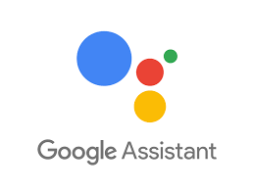







EXISTING SYSTEMS
kEY LIMITATIONS
Internet Dependency
Privacy Risks
Limited Customization:
Restricted Automation

Slide 8
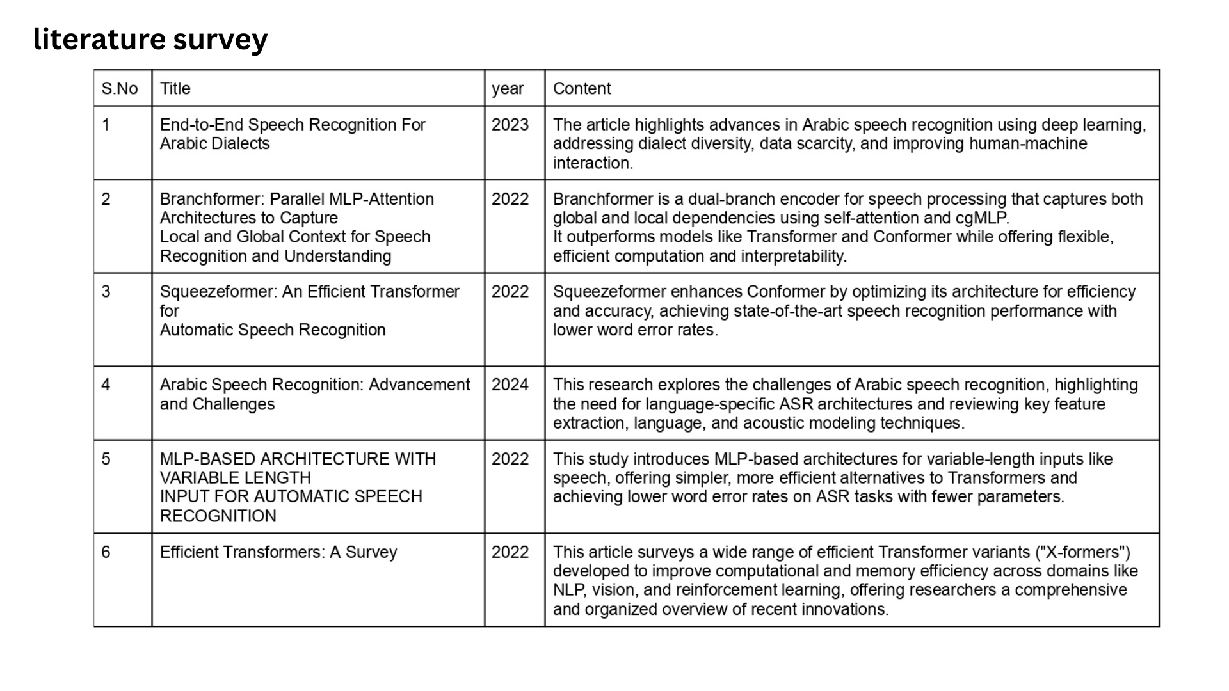

Slide 9
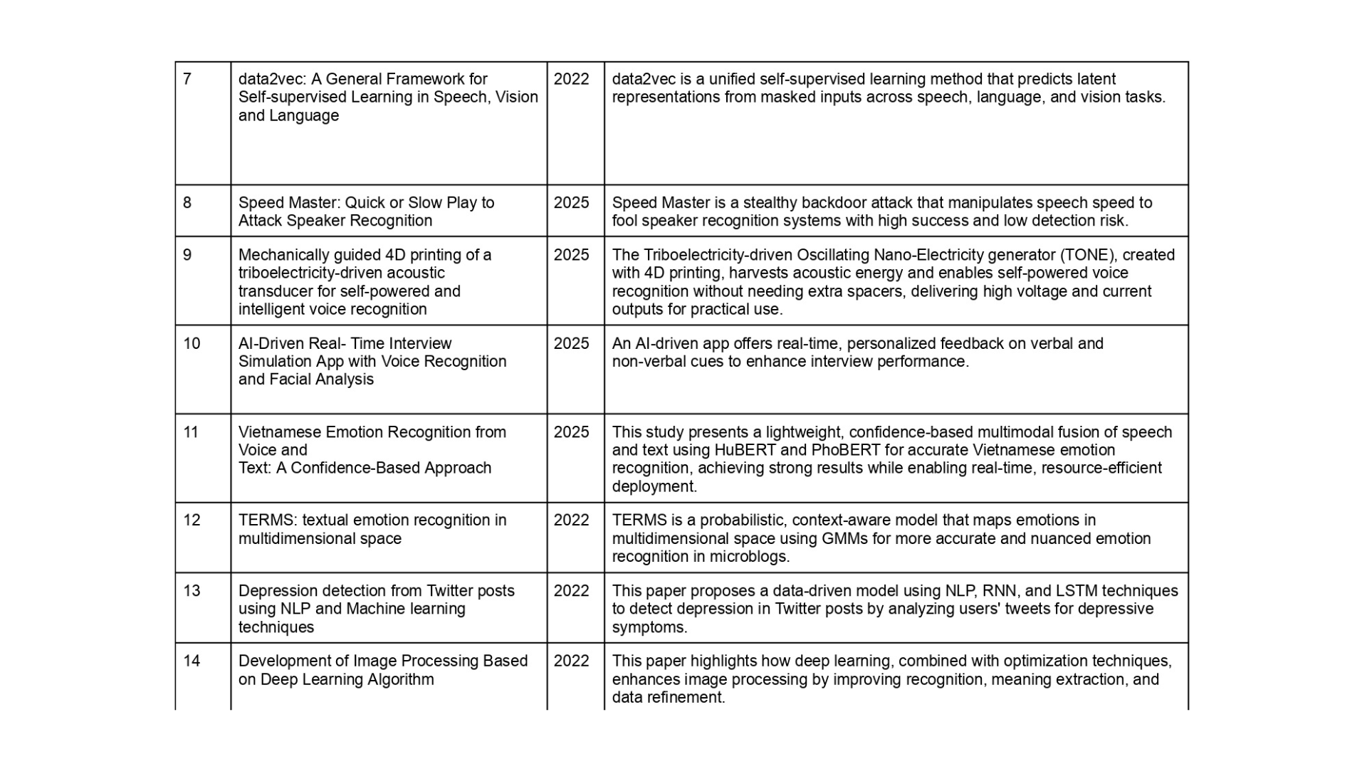

Slide 10
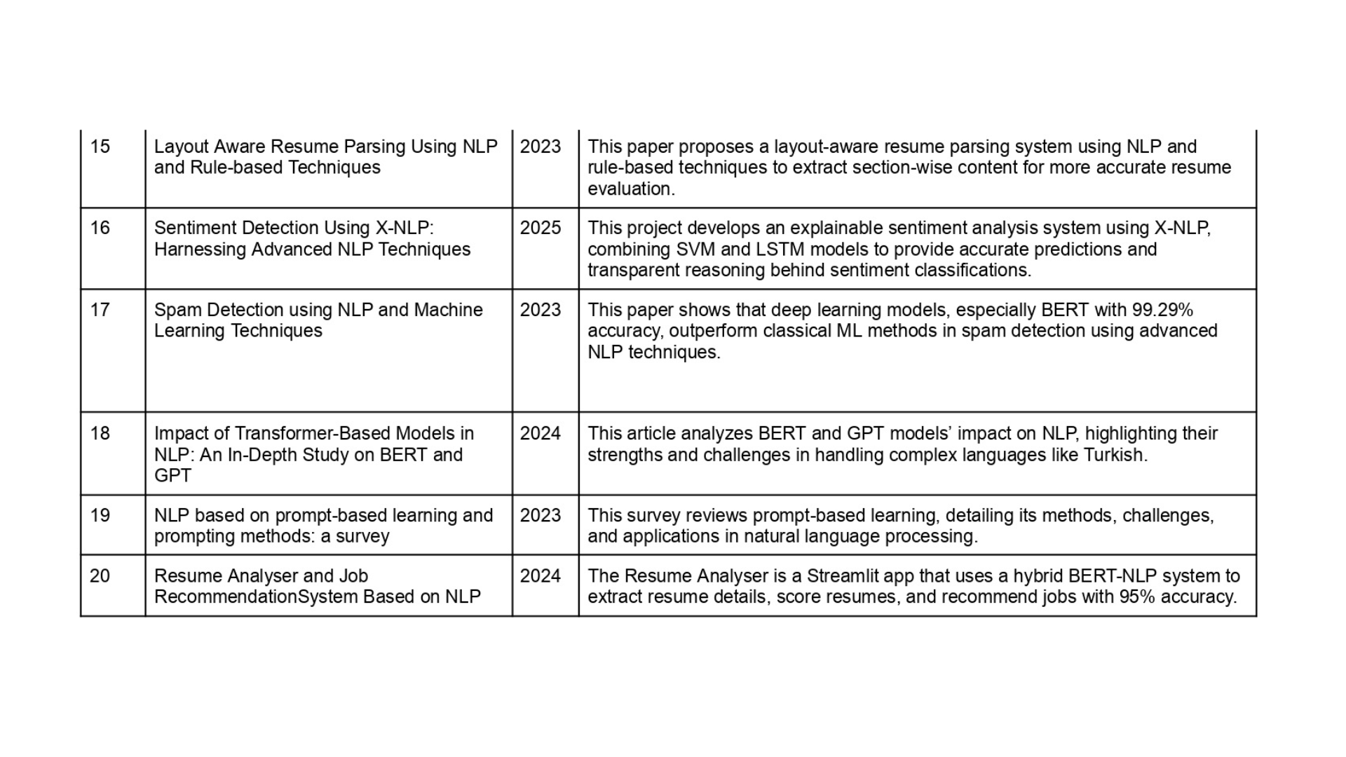

Slide 11





(VOXCMD Architecture)
PROPOSED SYSTEM
Secure & Multi-Agent Architecture
Agent Categories
Personal Productivity
Core AI Logic
Developer Tools
System Automation
Information & Web
Social/Media Tools

Slide 12




PROPOSED METHODOLOGY
NLP Processing
Task Execution
Voice Input
Agent Selection

Slide 13
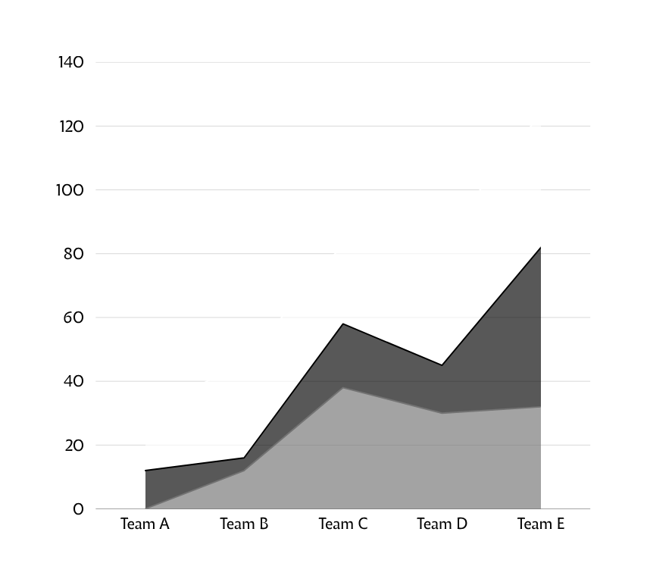
RESULT
VoxCMD successfully demonstrates a reliable offline AI voice command system suitable for automation, privacy-focused applications, and local system control.”

Slide 14





HARDWARE & SOFTWARE REQUIREMENTS
Laptop
Supported OS
Minimum 4GB RAM and dual-core processor.
Microphone
Windows
Mac
Linux
Built-in or external for clear voice capture.

Slide 15
CONCLUSION
Revolutionary Offline AI Voice Automation
Privacy-First: VoxCMD eliminates cloud dependency, delivering a fully local and private voice command experience.
Secure & Customizable: Multi-agent system ensures user control and open-source transparency.
Productivity Bridge: Seamlessly connects development, automation, and daily workflows on one platform.
Zero data collection while maintaining advanced AI capabilities.

Slide 16
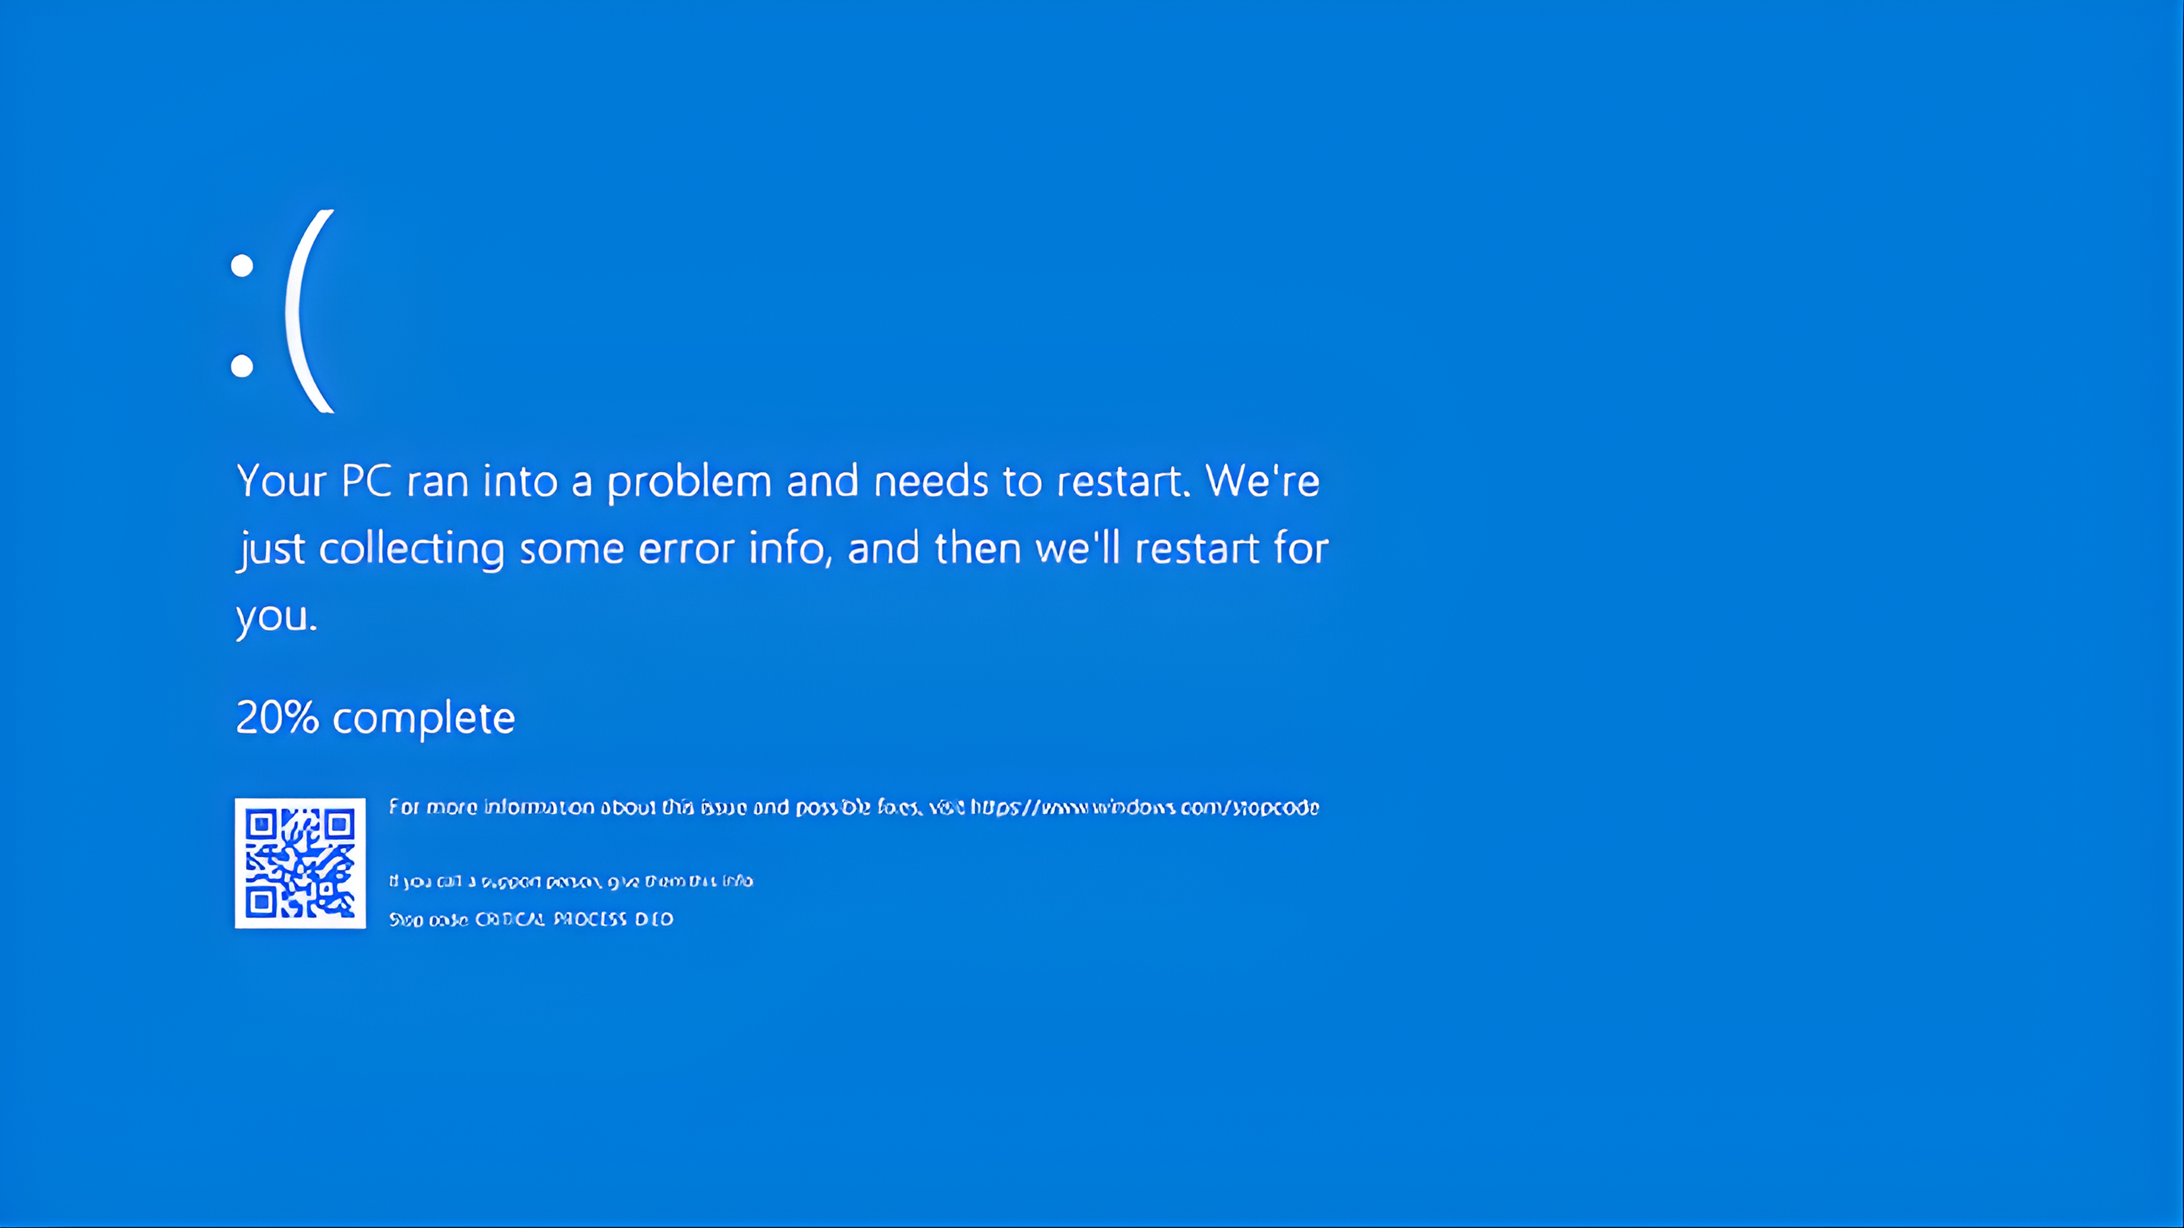

Slide 17
WHAT
NEXT

Slide 18
